Slide 1

SECA4002 – DEEP LEARNING NEURAL NETWORKS
Dr. V. Vedanarayanan B.E., M.E., PhD
Course Co-ordinator
Assistant Professor, Department of ECE,
School of Electrical and Electronics
SATHYABAMA INSTITUTE OF SCIENCE AND TECHNOLOGY

Slide 2

Course Outcomes
SECA4002 – DEEP LEARNING NEURAL NETWORKS
At The end of this Course, Student will be able to
CO1 | Select suitable model parameters for different machine learning techniques
CO2 | Evaluate the performance of existing deep learning models for various applications
CO3 | Realign high dimensional data using reduction techniques
CO4 | Analyze the performance of various optimization and generalization techniques in deep learning
CO5 | Modify the existing architectures for domain specific applications
CO6 | Develop a real time application using deep learning neural networks

Slide 3
Course Objectives
SECA4002 – DEEP LEARNING NEURAL NETWORKS
Course Objectives:
To present the mathematical, statistical and computational challenges of building neural networks
To study the concepts of deep learning
To introduce dimensionality reduction techniques
To enable the students to know deep learning techniques to support real-time applications
To examine the case studies of deep learning techniques

Slide 4
SECA4002 – DEEP LEARNING NEURAL NETWORKS
Detailed Syllabus:
UNIT 3: DIMENTIONALITY REDUCTION
Linear (PCA, LDA) and manifolds, metric learning - Auto encoders and dimensionality reduction in networks - Introduction to Convnet - Architectures – AlexNet, VGG, Inception, ResNet - Training a Convnet: weights initialization, batch normalization, hyperparameter optimization.

Slide 5
SECA4002 – DEEP LEARNING NEURAL NETWORKS
Recommended Text Books/ Reference Books
Cosma Rohilla Shalizi, Advanced Data Analysis from an Elementary Point of View, 2015.
Deng & Yu, Deep Learning: Methods and Applications, Now Publishers, 2013.
Ian Goodfellow, Yoshua Bengio, Aaron Courville, Deep Learning, MIT Press, 2016.
Michael Nielsen, Neural Networks and Deep Learning, Determination Press, 2015.

Slide 6
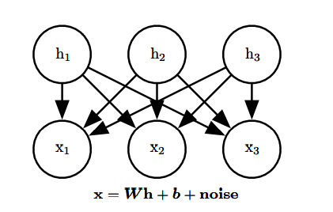
Linear factor Models
linear factor models are used as building blocks of mixture modelsor of larger, deep probabilistic models
A linear factor model is defined by the use of a stochastic linear decoder function that generates x by adding noise to a linear transformation of h
allow us to discover explanatory factors that have a simple joint distribution
A linear factor model describes the data-generation process as follows.
we sample the explanatory factors h from a distribution
h ∼ p(h)
From the above Diagram, the observed data vector x is obtained by a linear combination of independent latent factors h, plus some noise

Slide 7
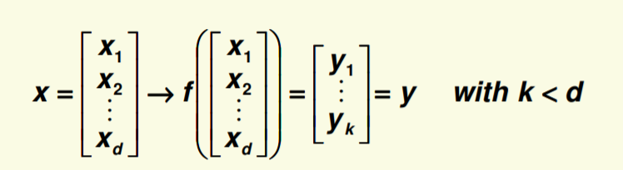
Linear factor Models
Different models, such as probabilistic PCA, factor analysis or ICA, make different choices about the form of the noise and of the prior p(h).
where p(h) is a factorial distribution, with p(h) = Π i p(hi),
Next we sample the real-valued observable variables given the factors x = W h + b + noise,
where the noise is typically Gaussian and diagonal
Dimensionality Reduction:
High dimensionality is challenging and redundant
It is natural to try to reduce dimensionality
We reduce the dimensionality by feature combination i.e., combine old features X to create new features Y

Slide 8
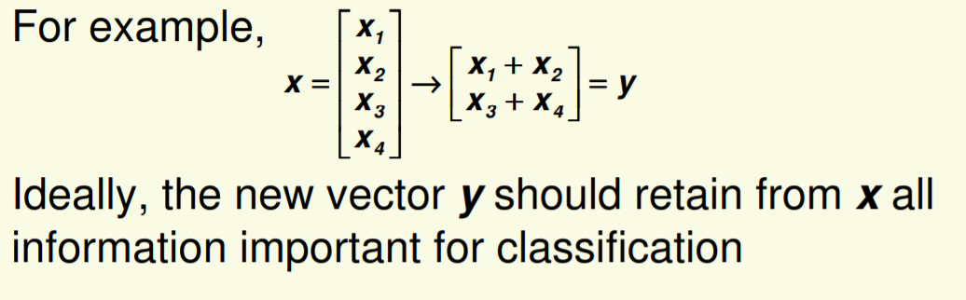
Dimensionality Reduction
An important machine learning method for dimensionality reduction is called Principal Component Analysis.

Slide 9
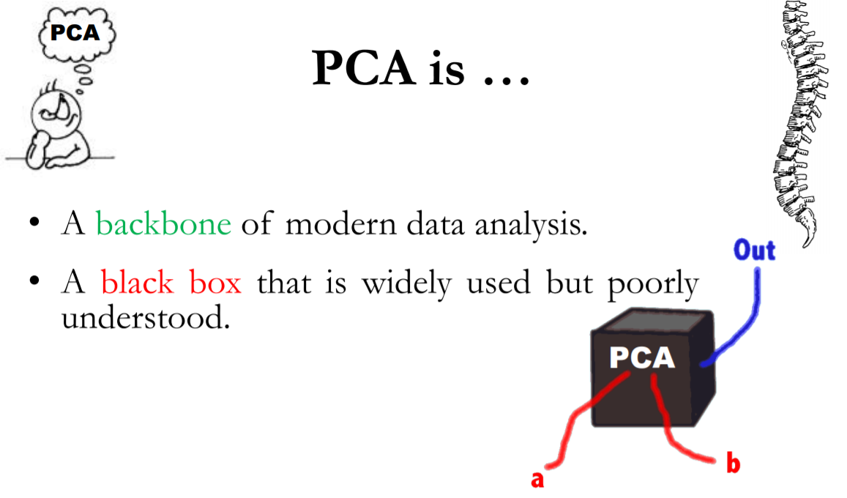
Principle Component Analysis - PCA
It is a method that uses simple matrix operations from linear algebra and statistics to calculate a projection of the original data into the same number or fewer dimensions.
t can be thought of as a projection method where data with m-columns (features) is projected into a subspace with m or fewer columns, whilst retaining the essence of the original data.
PCA is an operation applied to a dataset, represented by an n x m matrix A that results in a projection of A which we will call B.
Image Source: http://www.sci.utah.edu/~shireen/pdfs/tutorials/Elhabian_PCA09.pdf

Slide 10
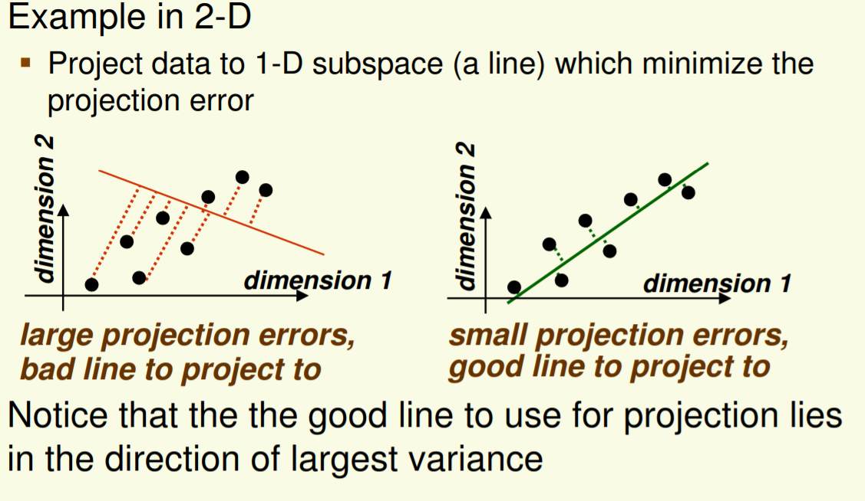
Principle Component Analysis - PCA
It is a mathematical tool from applied linear algebra.
It is a simple, non-parametric method of extracting relevant information from confusing data sets.
It provides a roadmap for how to reduce a complex data set to a lower dimension.
Main idea: seek most accurate data representation in a lower dimensional space
Image Source: https://www.csd.uwo.ca/~oveksler/Courses/CS434a_541a/Lecture7.pdf

Slide 11
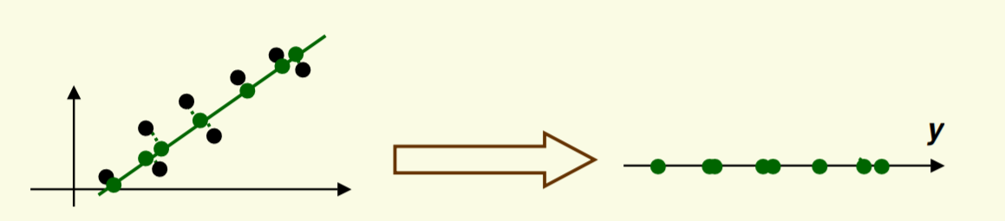
Principle Component Analysis - PCA
After the data is projected on the best line, need to transform the coordinate system to get 1D representation for vector y
Note that new data y has the same variance as old data x in the direction of the green line PCA preserves largest variances in the data.
Image Source: https://www.csd.uwo.ca/~oveksler/Courses/CS434a_541a/Lecture7.pdf

Slide 12
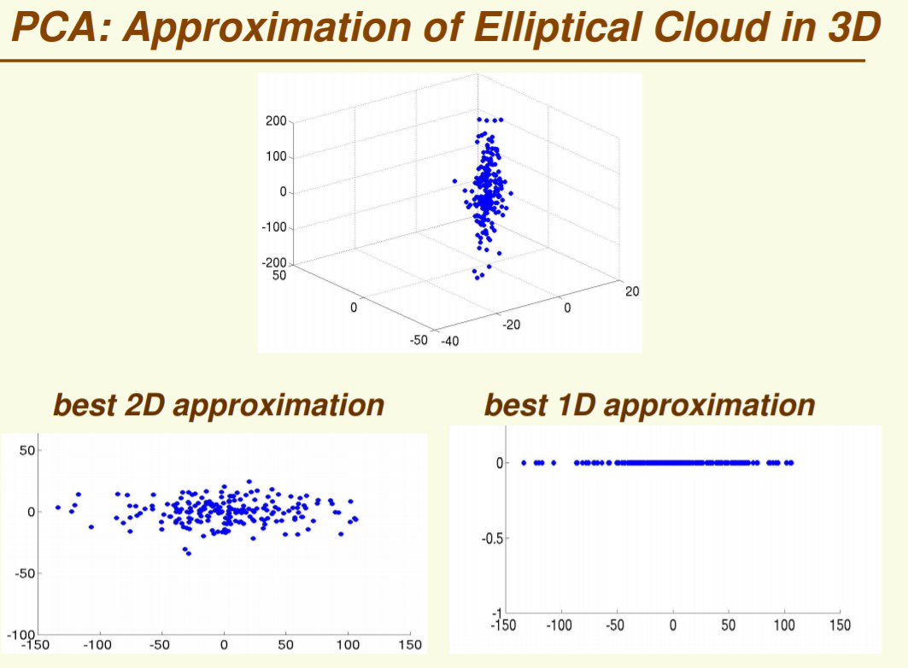
Principle Component Analysis - PCA

Slide 13
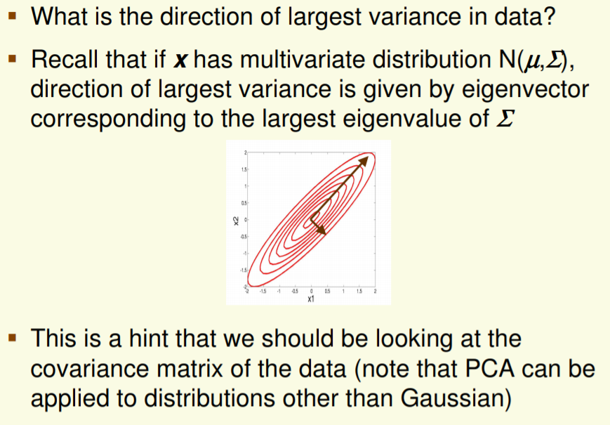
Principle Component Analysis - PCA

Slide 14
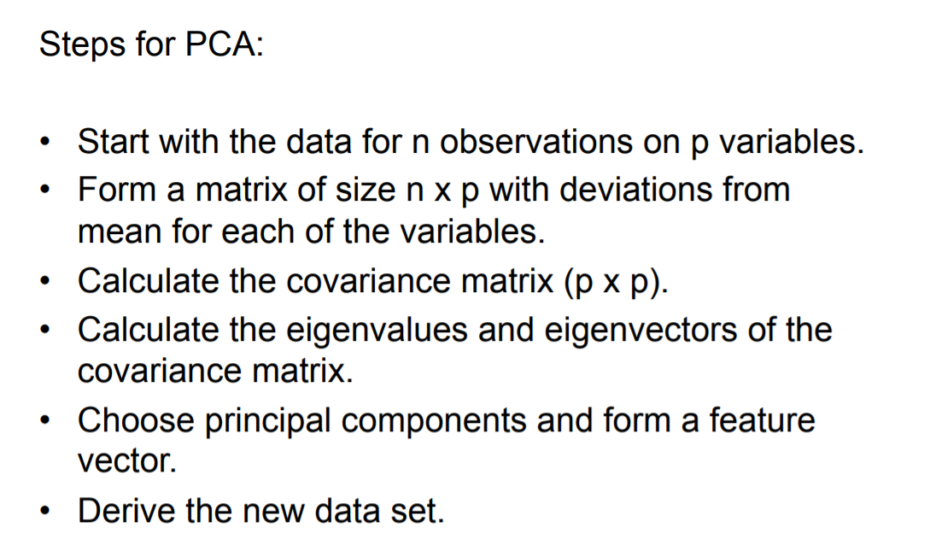
Principle Component Analysis -STEPs

Slide 15
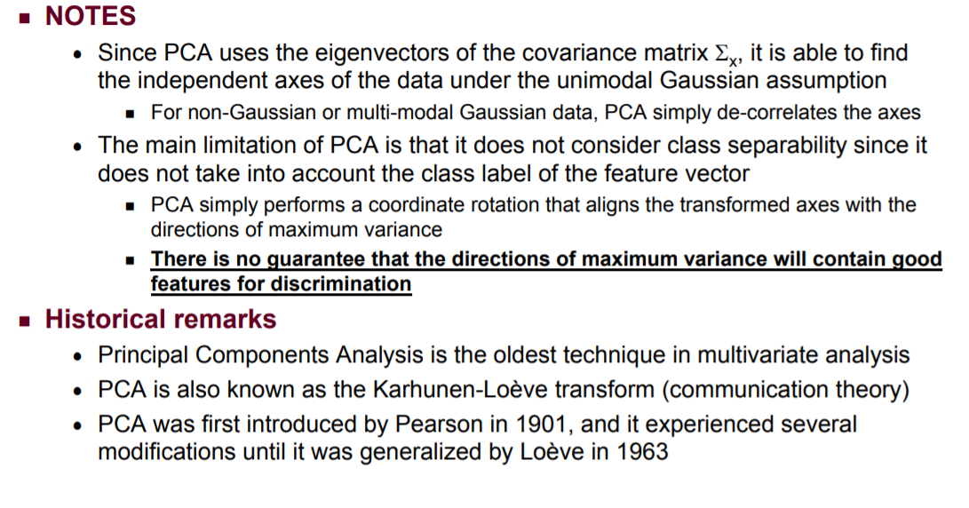
Principle Component Analysis -STEPs

Slide 16
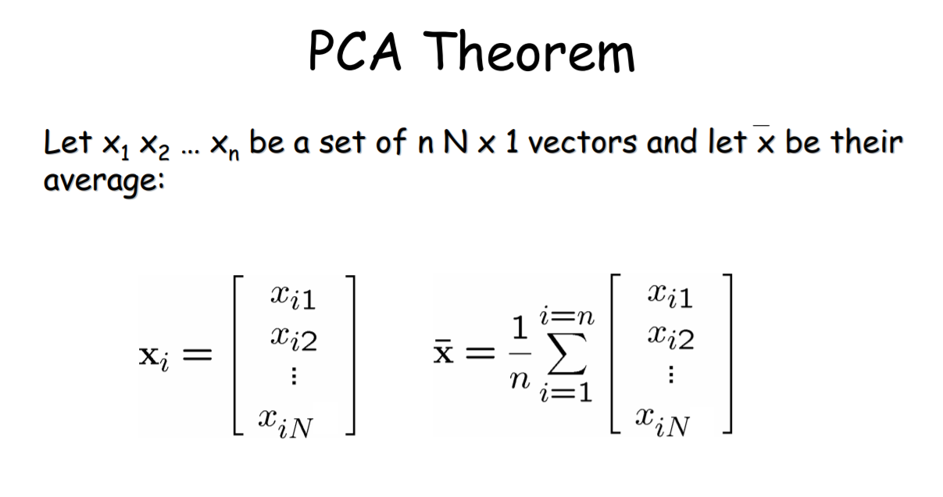
Principle Component Analysis -PCA
By finding the eigenvalues and eigenvectors of the covariance matrix, we find that the eigenvectors with the largest eigenvalues correspond to the dimensions that have the strongest correlation in the dataset. This is the principal component.
PCA is a useful statistical technique that has found application in: – fields such as face recognition and image compression – finding patterns in data of high dimension.

Slide 17
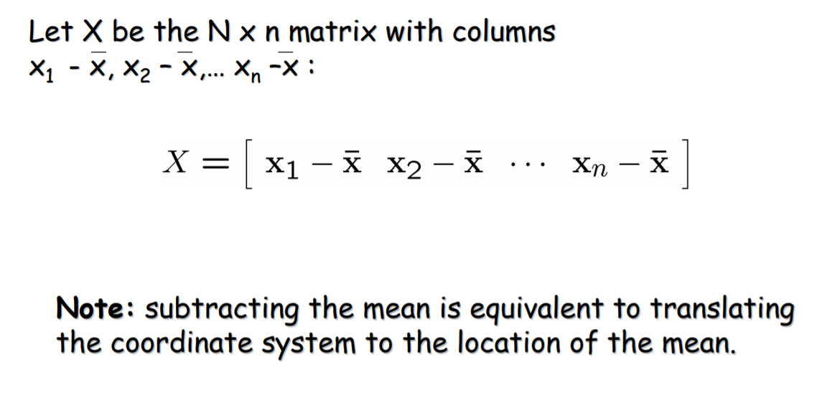
Principle Component Analysis

Slide 18
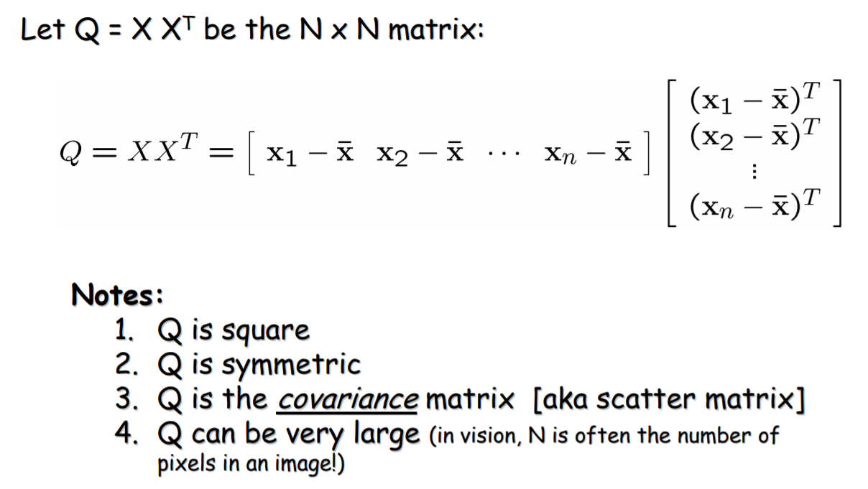
Principle Component Analysis

Slide 19
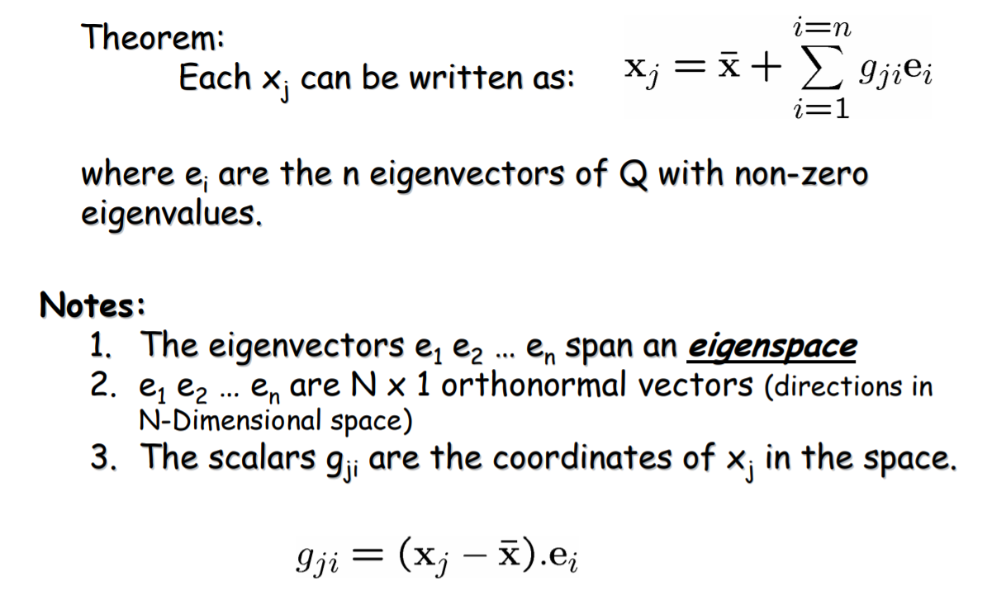
Principle Component Analysis

Slide 20
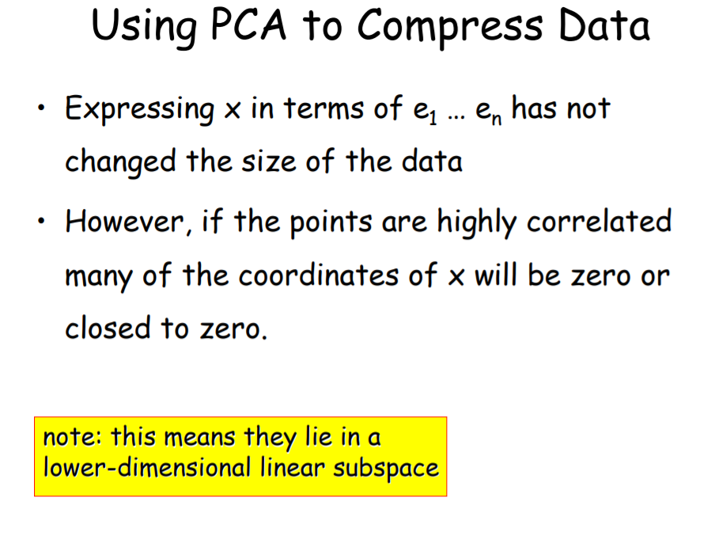
Principle Component Analysis

Slide 21
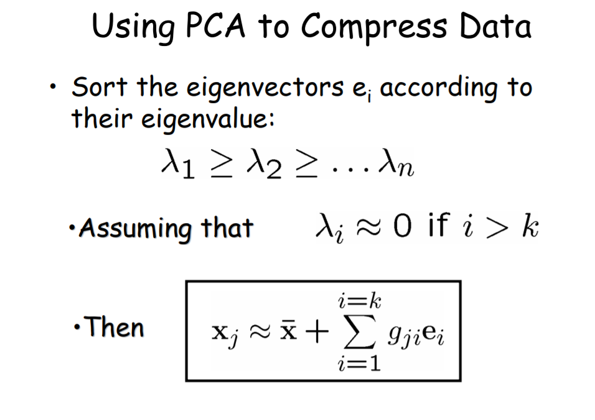
Principle Component Analysis

Slide 22
Principle Component Analysis - Advantages
Removes Correlated Features:
In a real world scenario, it is very common that we get thousands of features in our dataset. You cannot run your algorithm on all the features as it will reduce the performance of your algorithm and it will not be easy to visualize that many features in any kind of graph. Hence the data set should be reduced.
We need to find out the correlation among the features (correlated variables). Finding correlation manually in thousands of features is nearly impossible, frustrating and time-consuming. PCA performs this task effectively
After implementing the PCA on your dataset, all the Principal Components are independent of one another. There is no correlation among them.
2. Improves Algorithm Performance:
With so many features, the performance of your algorithm will drastically degrade. PCA is a very common way to speed up your Machine Learning algorithm by getting rid of correlated variables which don't contribute in any decision making. The training time of the algorithms reduces significantly with less number of features.
So, if the input dimensions are too high, then using PCA to speed up the algorithm is a reasonable choice.

Slide 23
Principle Component Analysis - Advantages & Disadvantages
3. Reduces Overfitting: Overfitting mainly occurs when there are too many variables in the dataset. So, PCA helps in overcoming the overfitting issue by reducing the number of features. 4. Improves Visualization: It is very hard to visualize and understand the data in high dimensions. PCA transforms a high dimensional data to low dimensional data (2 dimension) so that it can be visualized easily. We can use 2D Scree Plot to see which Principal Components result in high variance and have more impact as compared to other Principal Components.
Disadvantages of Principal Component Analysis 1. Independent variables become less interpretable: After implementing PCA on the dataset, your original features will turn into Principal Components. Principal Components are the linear combination of your original features. Principal Components are not as readable and interpretable as original features. 2. Data standardization is must before PCA: You must standardize your data before implementing PCA, otherwise PCA will not be able to find the optimal Principal Components.

Slide 24
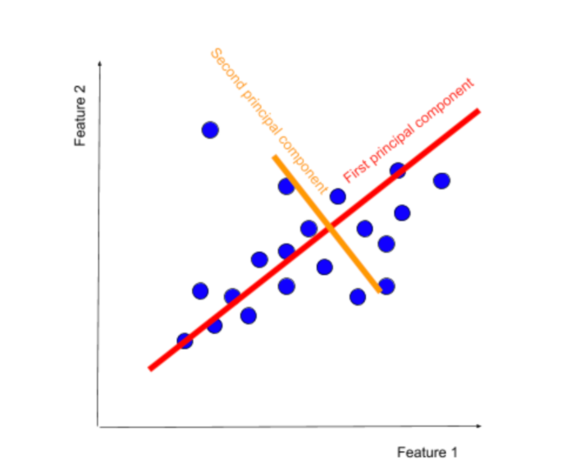
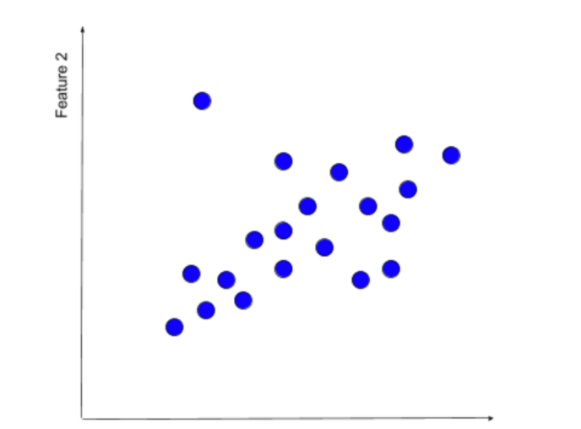

Principle Component Analysis - Advantages & Disadvantages
Disadvantages of Principal Component Analysis 3. Information Loss: Although Principal Components try to cover maximum variance among the features in a dataset, if we don't select the number of Principal Components with care, it may miss some information as compared to the original list of features.

Slide 25
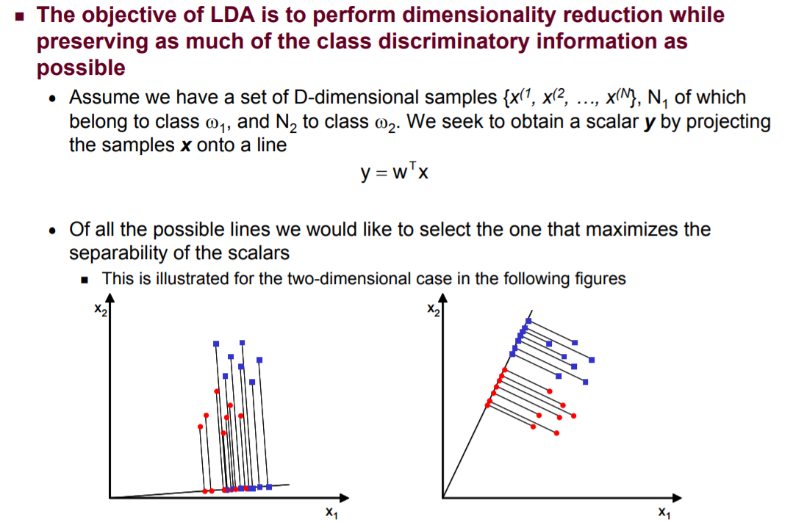
Linear Discriminative Analysis - LDA
Content & Image Source: http://www.facweb.iitkgp.ac.in/~sudeshna/courses/ml08/lda.pdf

Slide 26
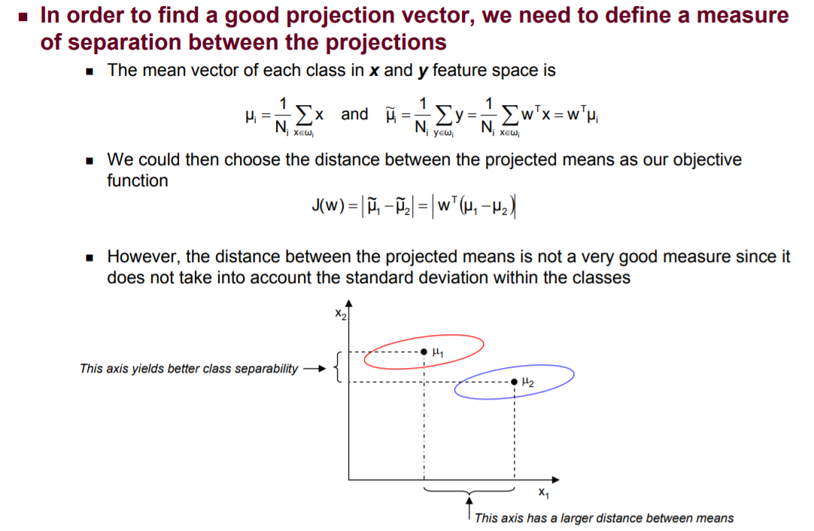
Linear Discriminative Analysis - LDA
Content & Image Source: http://www.facweb.iitkgp.ac.in/~sudeshna/courses/ml08/lda.pdf

Slide 27
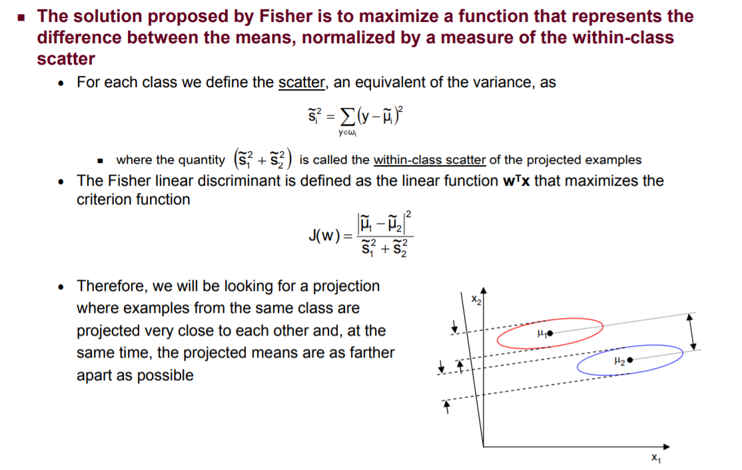
Linear Discriminative Analysis - LDA
Content & Image Source: http://www.facweb.iitkgp.ac.in/~sudeshna/courses/ml08/lda.pdf

Slide 28
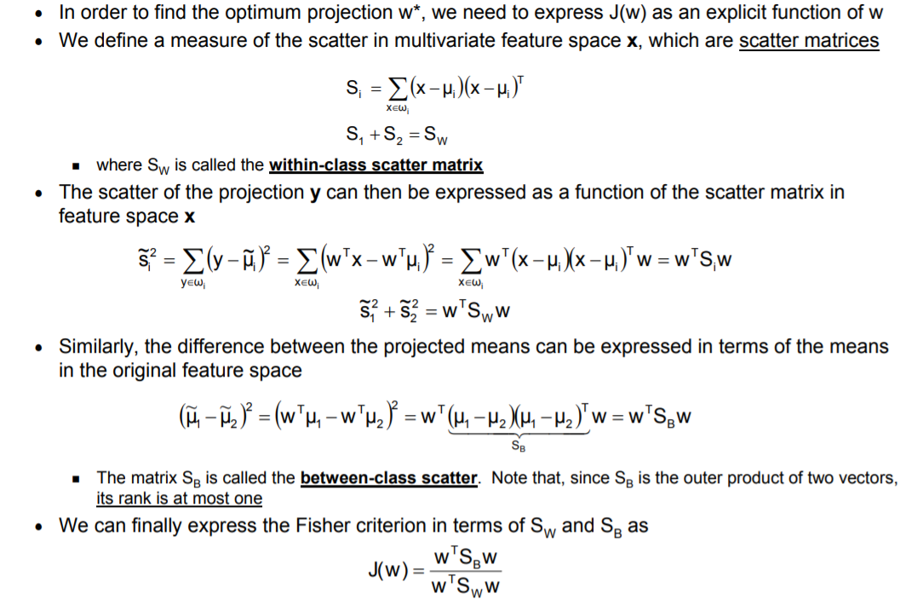
Linear Discriminative Analysis - LDA
Content & Image Source: http://www.facweb.iitkgp.ac.in/~sudeshna/courses/ml08/lda.pdf

Slide 29
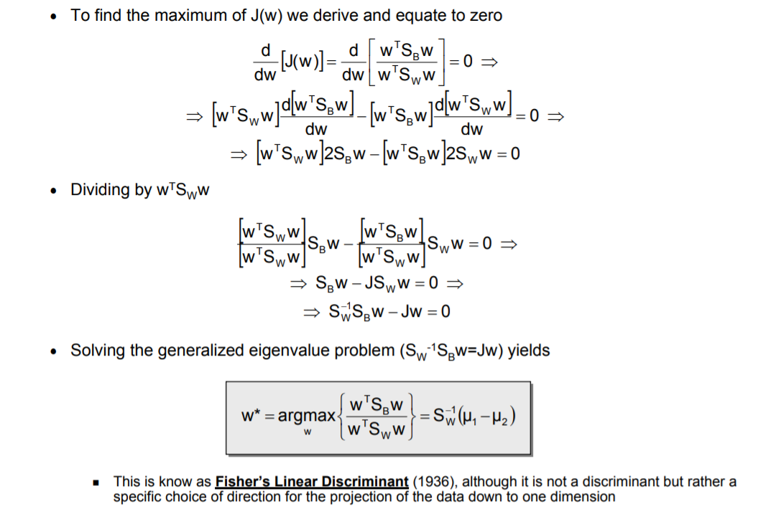
Linear Discriminative Analysis - LDA
Content & Image Source: http://www.facweb.iitkgp.ac.in/~sudeshna/courses/ml08/lda.pdf

Slide 30
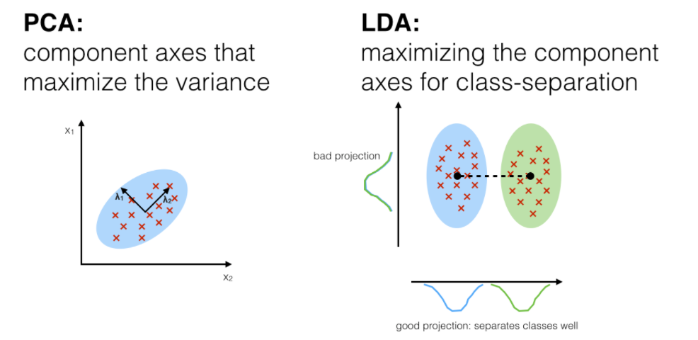
PCA Vs LDA
Content & Image Source: https://sebastianraschka.com/Articles/2014_python_lda.html

Slide 31
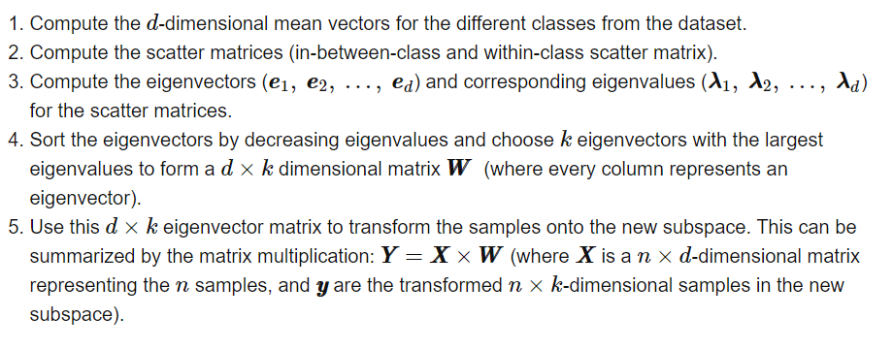
LDA in 5simple steps
Content & Image Source: https://sebastianraschka.com/Articles/2014_python_lda.html

Slide 32
LDA – Pros & Cons
Advantages of LDA:
Simple prototype classifier: Distance to the class mean is used, it’s simple to interpret.
Decision boundary is linear: It’s simple to implement and the classification is robust.
Dimension reduction: It provides informative low-dimensional view on the data, which is both useful for visualization and feature engineering.
Shortcomings of LDA:
Linear decision boundaries may not adequately separate the classes. Support for more general boundaries is desired.
In a high-dimensional setting, LDA uses too many parameters. A regularized version of LDA is desired.
Support for more complex prototype classification is desired.
Content & Image Source: https://yangxiaozhou.github.io/data/2019/10/02/linear-discriminant-analysis.html

Slide 33

Dr. V. Vedanarayanan B.E., M.E., PhD
Assistant Professor, Department of ECE,
School of Electrical and Electronics
Sathyabama Institute of Science and technology
Vedanarayanan.etc@sathyabama.ac.in
This Photo by Unknown Author is licensed under CC BY

